Slide 1
Shell Bootcamp 2024 3 Reflections for Week 3
Debarshi Goswami
Date : 6-Sep-2024

Slide 2

About Me
The only person you are destined to become is the person you decided to be

Slide 3

My learnings from this week!

Slide 4

Learning 1 | My takeaways
Testing: Understanding various testing methodologies is crucial for crafting software that is robust and devoid of errors.
Principal Insight: Each phase of the software development process necessitates distinct testing approaches.
Utilization in the Energy Industry: Stability and safety are paramount for applications within the energy domain to avert mishaps, with comprehensive testing serving as a guarantee of these attributes.

Slide 5
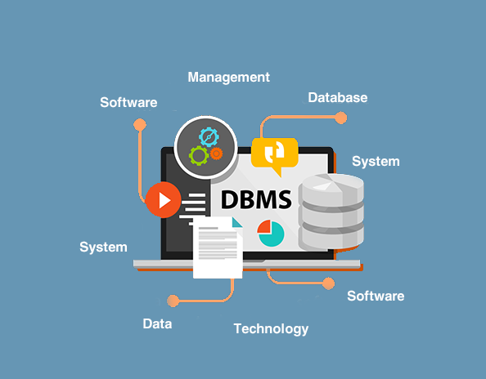
Learning 2 | My takeaways
Database Management System
Key learning A Database Management System (DBMS) is essential for the effective storage, administration, and protection of extensive data collections. Fundamental principles include relational database structures, the use of SQL for database interaction, and the management of transactions to maintain data accuracy and uniformity.
Key takeaway DBMS enhances decision-making, real-time data analysis, and workflow efficiency by securely managing large-scale data and reducing redundancy.
Implementation in the Energy sector DBMS helps manage vast energy-related data from sensors and smart grids, optimizing energy use, predicting maintenance, and supporting sustainability efforts while ensuring regulatory compliance and security.

Slide 6
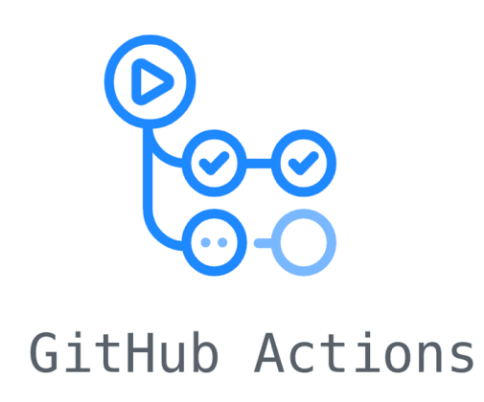
Learning 3 | My takeaways
Key Learning: GitHub Actions streamlines the processes of building, testing, and deploying code directly from repositories, enhancing efficiency and minimizing the need for manual intervention.
Key Takeaway: Automation enhances productivity and consistency in software development. By defining workflows that run tests or deploy applications upon specific events, projects are always up-to-date, tested, and deployed with minimal errors.
Energy Sector Application: GitHub Actions can ensure reliable and efficient software deployment in the energy sector.

Slide 7

Relevance of learnings for my organization

Slide 8

Learning 1 | Relevance for Shell
Shell adheres to Test-Driven Development (TDD), where each software component is unit tested to ensure proper functionality.
Given the deployment of software in the energy sector, safety is paramount at Shell. Preventing failures that could jeopardize the safety of users is crucial.

Slide 9
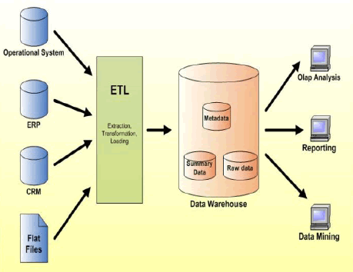
Learning 2 | Relevance for Shell
How I feel Shell implements this learning Shell uses DBMS to manage vast data from global operations, optimizing processes, real-time monitoring, and ensuring regulatory compliance, improving decision-making and sustainability efforts.
How I feel Shell benefits from this learning DBMS enhances Shell’s data management, enabling better resource allocation, predictive maintenance, and cost reduction. It also boosts data security, supporting innovation, sustainability, and maintaining a competitive edge.

Slide 10
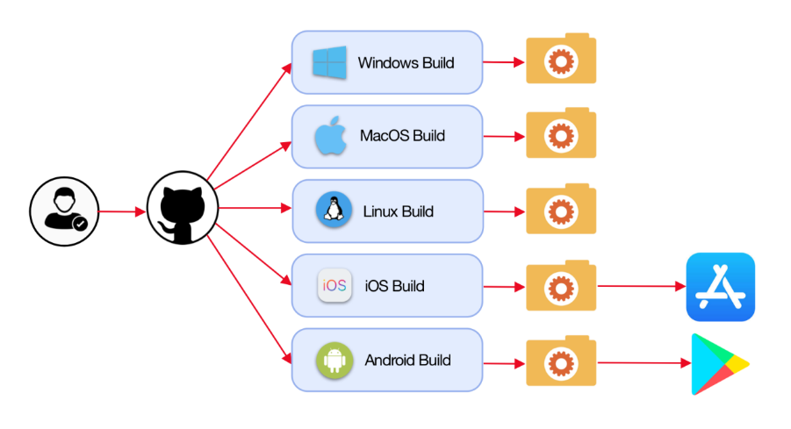
Learning 3 | Relevance for Shell
Shell and Automation:
Shell probably leverages GitHub Actions to automate its software workflows, ensuring that updates are swiftly and reliably tested before deployment. This approach aligns with Shell’s commitment to innovation and efficiency, fostering reliable and advanced solutions. Automation enhances development speed, minimizes downtime, and frees up developer time, leading to cost savings, better resource utilization, and improved operational resilience.

Slide 11

Challenges in implementing learning

Slide 12
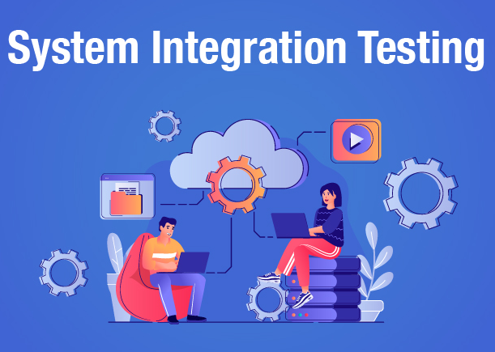
Challenge faced while implementing Learning 1
I am not that accustomed to using JUnit for unit testing, but I recently learned to use the Fitnesse tool, which was a new experience.
System testing and integration testing were unfamiliar to me, so it took some effort and trial and error to figure out how they work.

Slide 13
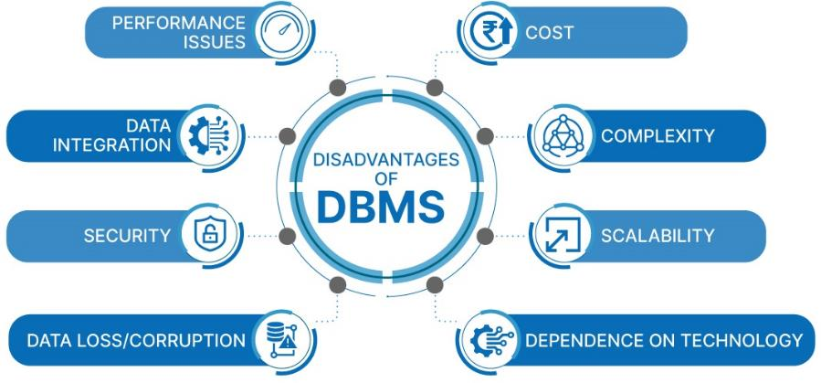
Challenge faced while implementing Learning 2
A key challenge was integrating DBMS with existing systems while ensuring data consistency and efficient migration. Managing large datasets and optimizing query performance for real-time analytics was also difficult. To address this, I plan to enhance my DBMS knowledge, explore migration tools and indexing techniques, and collaborate with colleagues while leveraging Shell’s training resources for a smoother implementation.

Slide 14
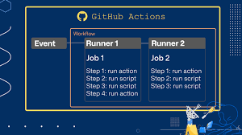
Challenge faced while implementing Learning 3
The primary challenges I faced included properly structuring workflows in YAML, handling complex pipelines, and troubleshooting integrations with third-party tools. Debugging failed workflows was particularly tough due to limited logging and error visibility.
My Plan to Overcome These Challenges: To address these issues, I plan to: Study YAML and GitHub Actions documentation more thoroughly. Use reusable workflows for consistency. Implement better logging and monitoring for easier debugging. Seek advice from experienced colleagues or the GitHub community. Test smaller workflow components before full integration.

Slide 15

Action Plan

Slide 16
My Action Plan for this Week
Actions
Timeline
Status
Understand all the technical skills being thought in the week.
Understand how these technical skills be implemented while working.
Implement all the learnings in the week.
Implementation should be on the same day as the learning.
Keep learning through out the week.
Implemented the different learnings like Agile(Scrum, Kanban), DBMS concepts, Cloud and

Slide 17

Learning is also Fun!

Slide 18
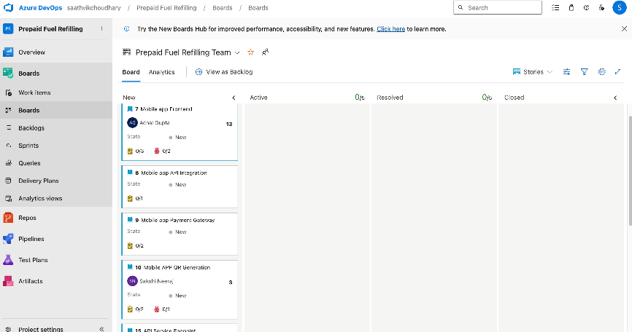
Learning is also Fun!
This week’s classes were very interactive and informative. All the lessons were in depth and backed by example along with practical implementation during the class it self.
We also had a scrum roleplay as a team to get us accustomed to the scrum framework.

Slide 19

Summary
Quick summary
Importance of topics of upcoming week
Connectivity of topics from current week

Slide 20
Thank You

